Slide 1
Solutions

Slide 2
Solubility Terminology
A solution is a mixture in which particles of one or more substances (the solute) are distributed uniformly throughout another substance (the solvent), so that the mixture is homogeneous at the molecular or ionic level.
Solute is a substance dissolved in another substance, usually the component of a solution present in the lesser amount
A solvent dissolves other chemicals, usually the component of a solution present in the greater amount
When a solution can have solute added and dissolved, the solution is unsaturated.
When a solution cannot have solute added and dissolved, the solution is saturated
Supersaturation is a state of a solution that contains more of the dissolved material than could be dissolved by the solvent under normal circumstances.

Slide 3
Types of solutions
Concentration of a solution is a measure of the amount of solute that is dissolved in a given quantity of solvent.
  Solute substance being dissolved
  Solvent substance doing the dissolving
  Lemonade solution, solute is lemon juice and sugar, solvent is water.
Dilute solution is on that contains a small amount of solute
Concentrated solution contains a large amount of solute
  1 g NaCl per 100 g H2O would be dilute when compared to 30 g NaCl per 100 g H2O (a concentrated solution)

Slide 4
Factors that affect rate of dissolving
Three factors affect the rate that a solid substance will dissolve
Agitation, temperature and particle size
  Agitation or stirring a solution will make the crystals dissolve more quickly
  For solids dissolved in a liquid increasing the temperature will increase the rate at which the substance will dissolve.
  Larger particles will dissolve more slowly than smaller particles. Smaller particles (more surface area) dissolve much quicker
  Remember: crush it, heat it, stir it
  NOTE: For gasses dissolved in a liquid decreasing the temperature will allow an increase in the amount of gasses that can be dissolved. Also increasing the pressure will increase the amount of gas that can dissolve in a liquid.

Slide 5
Factors that affect rate of dissolving
Three factors affect the rate that a Gas substance will dissolve
Agitation, pressure and temperature
  gasses dissolved in a liquid decreasing the temperature will allow an increase in the amount of gasses that can be dissolved
  Also increasing the pressure will increase the amount of gas that can dissolve in a liquid.
  NOT agitating (no stirring or shaking) will increase the amount of gas a liquid can hold.

Slide 6
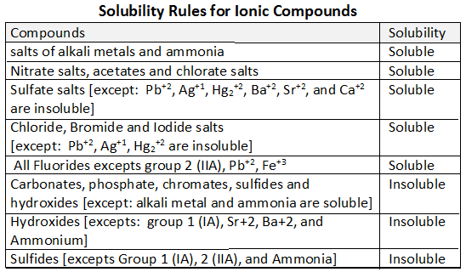
HONORS -- Solubility
You can predict the formation of a precipitate by using the general rules for solubility of ionic compounds
Soluble substances will NOT form a precipitate and will remain as ions in solution
Insoluble substances WILL form a precipitate (a solid product)

Slide 7
Solubility
Identify as Soluble or Insoluble
Cs₃PO₄
AgCl
Sr(OH)₂
(NH₄)₂S
Al₂S₃
PbBr₂
Al(NO₃)₃
Ca(OH)₂
ZnC₂H₃O₂
MgCO₃
Soluble (is an exception)
Insoluble (is an exception)
Soluble (is an exception)
Soluble (all ammonia)
Insoluble
Insoluble (is an exception)
Soluble
Insoluble
Soluble
Insoluble

Slide 8
Solubility
Predicting precipitate from double replacement reaction
Predict products based on a balance of charge and an exchange of ions between reactants [ AB + CD → AD +CB ]
Check solubility rules to determine if product are soluble
Example: Identify the precipitate formed when the following solutions are mixed
H⁺¹ Cl⁻¹ Ba⁺² SO₄⁻²
HCl + BaSO₄
Ca⁺² NO₃⁻¹ Pb⁺² Cl⁻¹
Ca(NO₃) ₂ + PbCl₂
Na⁺¹ Cl⁻¹ Cr+³ PO₄⁻³
NaCl + CrPO₄
H₂SO₄ + BaCl₂ →
CaCl₂ + Pb(NO₃)₂ →
Na₃PO₄ + CrCl₃ →

Slide 9
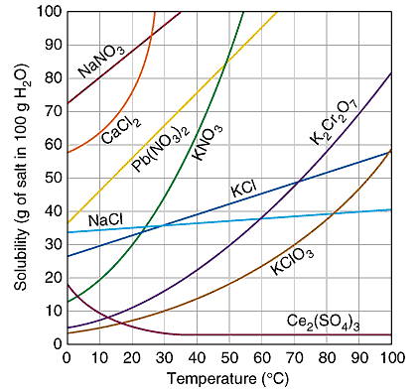
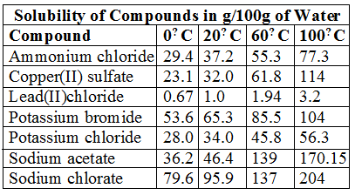
Solubility Curve and Table
A solubility graph like the one shown above is a graph where the lines graphed are representative of the solubility of various compounds.
can use these graphs to find the solubility of an element at certain temperatures in one hundred grams of water.
can also use it to determine if a solution is unsaturated, saturated, or super-saturated

Slide 10
Reading Solubility Charts
If the number in the problem is EQUAL to the value on the chart/graph the solution is considered SATURATED
If the number in the problem is LESS than the value on the chart/graph the solution is considered UNSATURATED
If the number in the problem is MORE than the value on the chart/graph the solution is considered SUPER SATURATED
Most charts/graphs are based on 100 g water. If water is doubled or tripled than the amount of salt is doubled or tripled

Slide 11
Reading Solubility Charts
Classify each as saturated, unsaturated or super saturated
40 g NaCl at 60°C
  Above line = super saturated
10 g KClO₃ at 30°C
  On line = saturated
51 g KCl at 90°C
  Below line = unsaturated
80 g NaNO₃ at 10°C
  On line = saturated
80 g CaCl₂ at 20°C
  Above line = super saturated

Slide 12
Reading Solubility Charts
How many grams of NaCl would be needed to make a saturated solution with 200 g of water at 40°C
What mass of water would be necessary to make a saturated solution containing 15 g KClO₃ at 70°C
What is the maximum temperature where a 45g KCl solution in 100 g water would be considered supersaturated?
36 g NaCl per 100 g water. 72 g total
30 g KClO₃ per 100 g water. 15 g ONLY
Approx. 58 °C is saturated point. Just below 58 °C

Slide 13
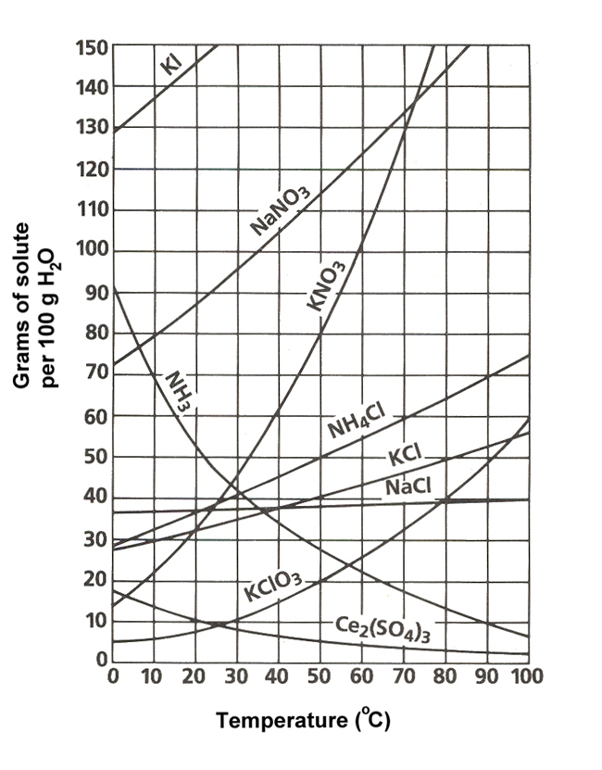

Slide 14
Solutions Basics
16.2 Concentrations of Solutions

Slide 15

Molarity
Molarity (M) is the number of moles of solute dissolved in one liter of solution
To calculate the molarity of a solution, divide the moles of solute by the volume of the solution.
Molarity is also known as molar concentration

Slide 16



Molarity Example
A saline solution contains 0.95 g NaCl in exactly 100 mL of solution. What is the molarity of the solution?
  Need moles of solute, so turn grams to moles
  0.95 g NaCl x _________
  Need liters of solution
  100 ml x ______
  Molarity =
= 0.016 mol NaCl
= 0.100 L
= 0.16 M NaCl

Slide 17

Molarity Example
A solution has a volume of 2.50 L and contains 159g NaCl. What is the molarity of the solution?
  Need moles of solute, so turn grams to moles
  0159 g NaCl x _________
  Molarity =
= 2.72 mol NaCl
= 1.09 M NaCl

Slide 18

Molarity Example
What mass of NaCl is needed to make a 2.25 M NaCl solution with a volume of 500 mL?
  Need liters of solution
  500 ml x ______
  Molarity x Liters = moles
  2.25 M NaCl x 0.500 L = 1.13 mol NaCl
  Turn mole to grams
  1.13 mol NaCl x
= 0.500 L
= 66.0 g NaCl

Slide 19
Molarity Practice (Chemical Formulas)
NaCl
Na₂S
HI
Al(OH)₃
H₂SO₄
Mg₃(PO₄)₂
NaCl
CaS

Slide 20
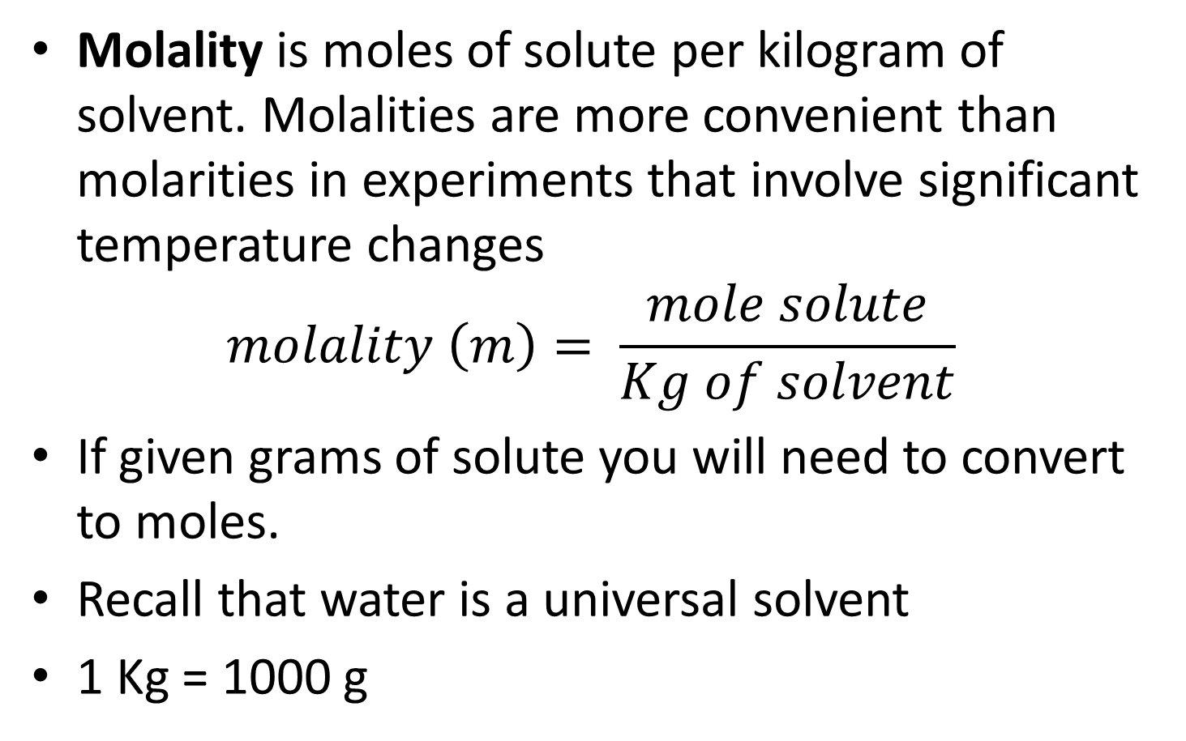
Molality
Molality is moles of solute per kilogram of solvent. Molalities are more convenient than molarities in experiments that involve significant temperature changes
$$molality \left(m\right)= \frac{mole solute}{Kg of solvent}$$
If given grams of solute you will need to convert to moles.
Recall that water is a universal solvent
1 Kg = 1000 g

Slide 21
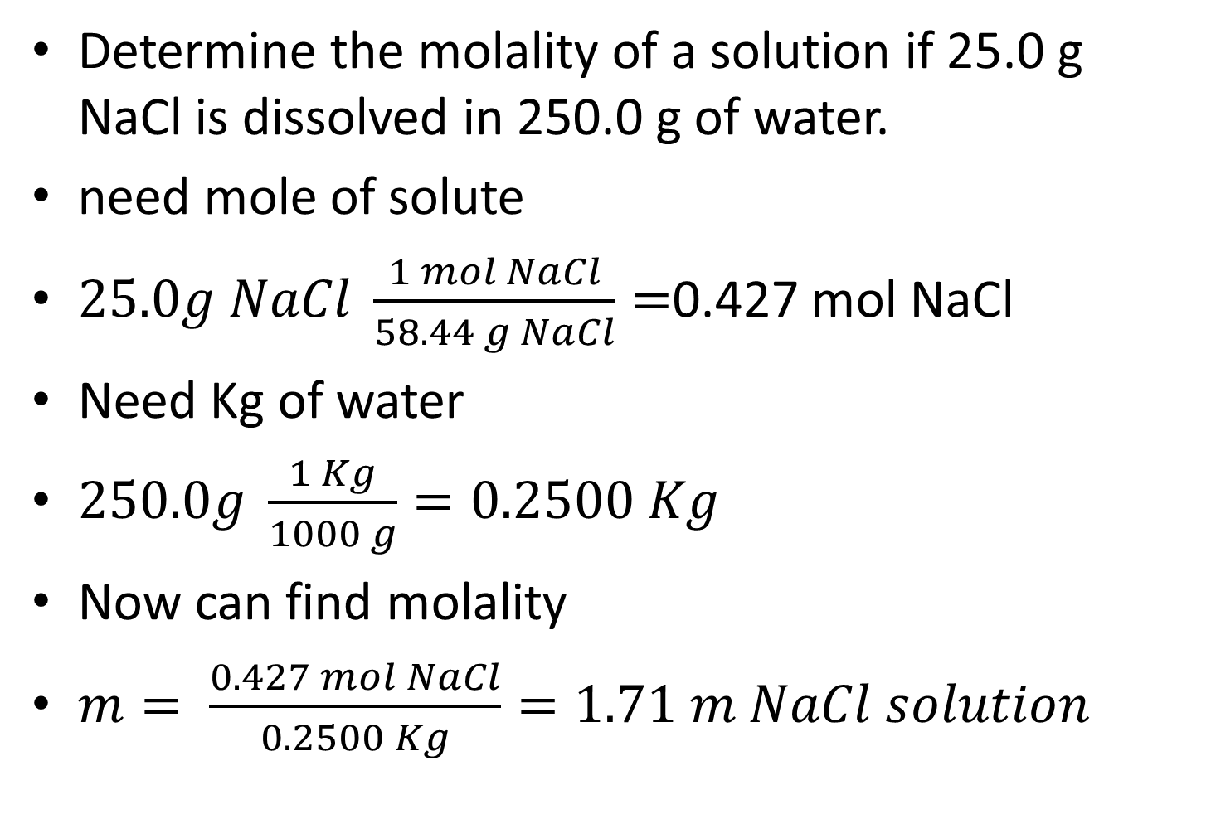
Molality example 1
Determine the molality of a solution if 25.0 g NaCl is dissolved in 250.0 g of water.
need mole of solute
$25.0g NaCl \frac{1 mol NaCl}{58.44 g NaCl}=$0.427 mol NaCl
Need Kg of water
$250.0g \frac{1 Kg}{1000 g}=0.2500 Kg$
Now can find molality
$m= \frac{0.427 mol NaCl}{0.2500 Kg}=1.71 m NaCl solution$

Slide 22
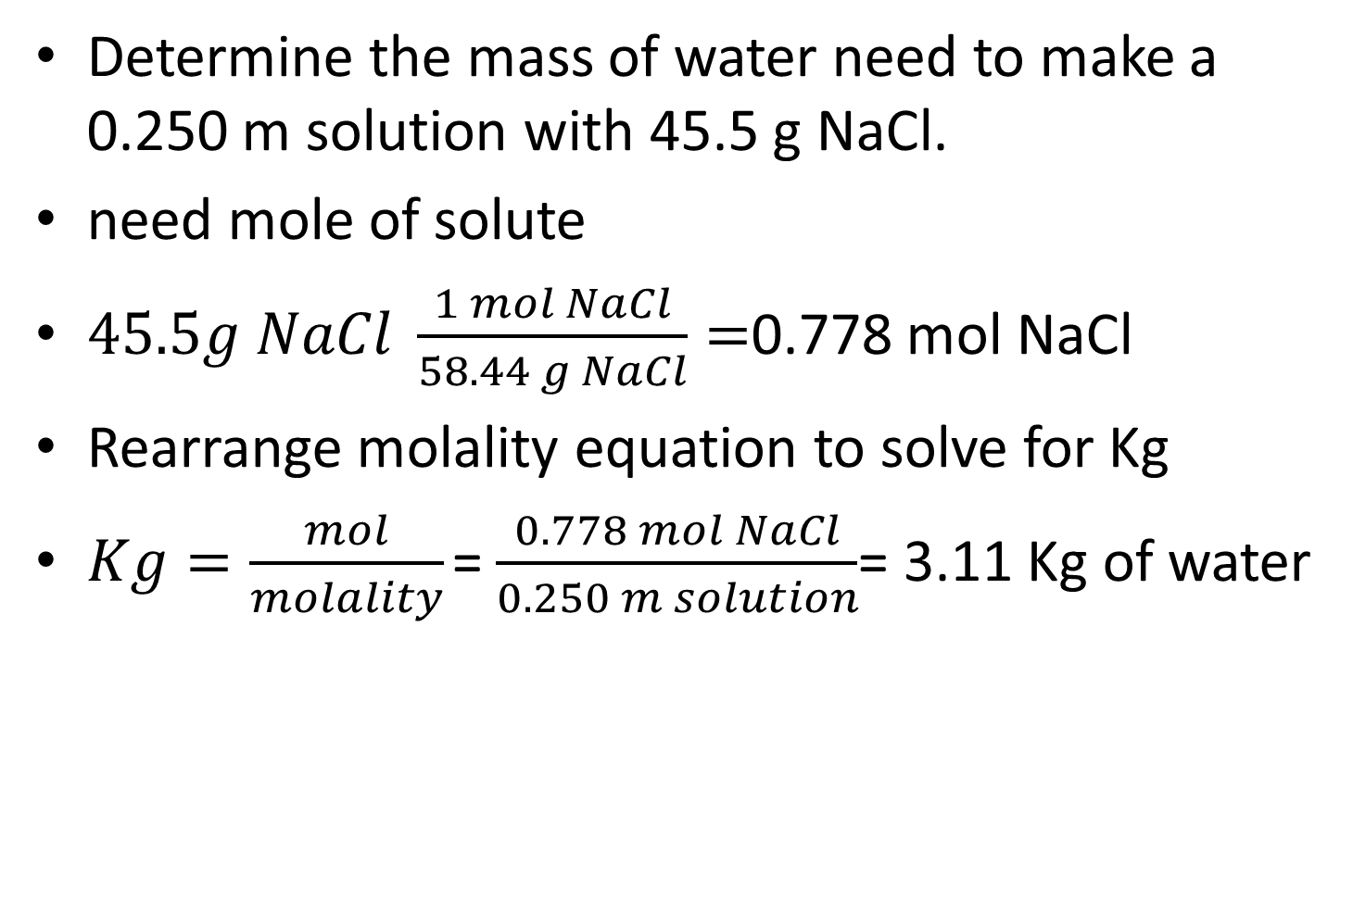
Molality example 2
Determine the mass of water need to make a 0.250 m solution with 45.5 g NaCl.
need mole of solute
$45.5g NaCl \frac{1 mol NaCl}{58.44 g NaCl}=$0.778 mol NaCl
Rearrange molality equation to solve for Kg
$Kg=\frac{mol}{molality}$ = $\frac{0.778 mol NaCl}{0.250 m solution}$= 3.11 Kg of water

Slide 23
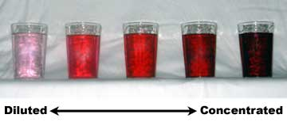
Dilution
  Dilution is the process of decreasing the concentration of a stock solution by adding more solvent to the solution.
  The solvent added is usually the universal solvent, known as water.
  The more solvent you add, the more diluted the solution will get.
  A stock solution is a concentrated solution that will be diluted to a lower concentration for actual use.

Slide 24
The Dilution Equation
  The equation for dilution is M₁V₁=M₂V₂
  M1= molarity of the stock solution
  M2= molarity of the diluted solution
  V1= volume of stock solution
  V2= volume of diluted solution
  In dilution equations, you are given three things and you need to find the forth component.
  The units for VOLUME must be the same
  Recall that 1 L = 1000 mL

Slide 25
Dilution Example #1
A stock solution of 1.00M of NaCl is available. How many milliliters are needed to make a 100.0 mL of 0.750M?
M1 = 1.00M,
V1 =???
M2= 0.750M and
V2= 100. mL
1.00M(V1) = 0.750M(100. mL)
V1 = 75.0mL

Slide 26
Dilution Example #2
Concentrated HCl is 12M. What volume in liters of HCl and water is needed to make 2.00L of a 1.0M solution?
M1 = 12M V1 = ??
M2=1.0M V2=2.00L
NOTE V1 will give volume of HCL
12 M (V1) = 1.0M (2.0L)
V1= 0.17 L of HCL
2.00L – 0.17 L = 1.83 L of water

Slide 27
Dilution Example #3
What is the final concentration if 55.0 mL of water is added to 5.0 mL of a 6.0 M soliton
M1 = 6.0M V1 = 5.0 mL
M2=?? V2= 55.0 mL + 5.0 mL = 60.0mL
6.0M(5.0mL) = M2(60.0mL)
M2= 0.50 M

Slide 28
Dilution Example #4
    You need 1.50 L of 0.750 M NaNO₃ from a solution known to be 5.50 M How many mL of the known NaNO₃ solution are required?
M1 = 5.50 M
V1 = ??
M2 = 0.750 M
V2 = 1.50 L
5.50 M (V1) = 0.750 M (1.50L)
V1 = 0.205 L
How many mL of water must be added to get desired volume?
1.50 L = 1500 mL
1500 mL – 205 mL = 1295 mL water added
or 205 mL of NaNO₃ solution are required

Slide 29
Colligative properties
A property that depends ONLY upon the number of solute particle and not upon their identity is called a colligative property.
Some colligative properties
  Color (for solutions with color)
  Taste (for solutions with taste)
  Density
  Vapor-pressure lowering
  Boiling-point elevation
  Freezing-point depression

Slide 30
Colligative properties
The decrease in vapor pressure is proportional to the number of particles the solute makes in solution.
The freezing-point depression is proportional to the number of solute particles dissolve din the solvent .
The boiling-point elevation is proportional to the number of solute particles dissolved in the solvent.
The more particles the greater the change in these colligative properties.

Slide 31
Colligative properties
How many particles are formed when the following solutes are dissolved?
  Remember that MOST ionic compounds will form ions and MOST covalent compounds will NOT.
NaCl
Mg₃N₂
CO₂
Al₂(SO₃)₃
C₆H₁₂O₆

Slide 32
Colligative properties calculations
ΔT_{b} = i K_{b} m or ΔT_{f} = i K_{f} m
ΔT is change in temperature (b for boiling, f for freezing)
i is number of particles or ions formed
m is the molality of the solution
K_{b} or K_{f} are the proportionality constant for that substance and are given to you.
Will need to know the boiling & freezing point for water

Slide 33
Colligative properties
Calculate the freezing-point depression and the freezing point of the solution if 2.42 mC₆H₆ (benzene) solution. K_{f} is 1.86 °C/m
ΔT_{f} = i K_{f} m
i is 1 b/c benzene is covalent
K_{f} for water is 1.86 °C/m
m is 2.42 m
Find ΔT_{f}
. ΔT_{f} = 1(1.86 °C/m)2.42m = 4.50 °C
Freezing point of water is 0.00°C so
Freezing point of solution 0.00°C- 4.50 °C = - 4.50 °C

Slide 34
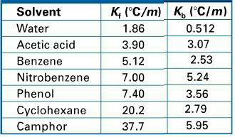
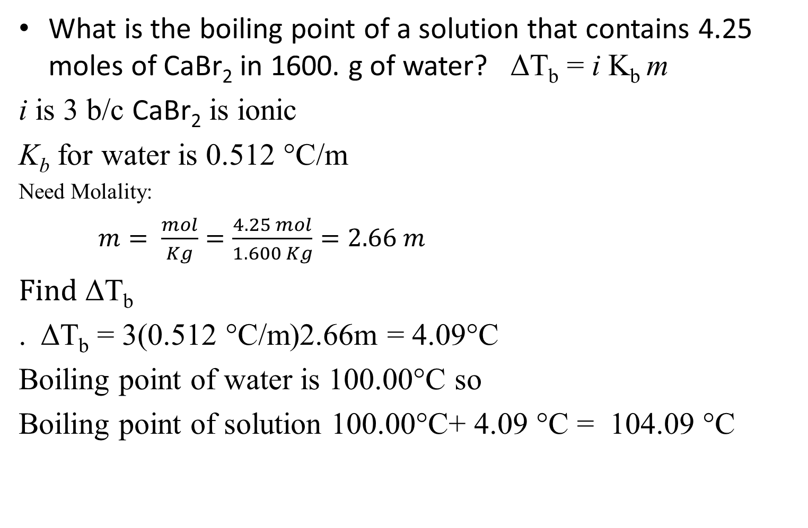
Colligative properties
What is the boiling point of a solution that contains 4.25 moles of CaBr₂ in 1600. g of water? ΔT_{b} = i K_{b} m
i is 3 b/c CaBr₂ is ionic
K_{b} for water is 0.512 °C/m
Need Molality:
$m= \frac{mol}{Kg}=\frac{4.25 mol}{1.600 Kg}=2.66 m$
Find ΔT_{b}
. ΔT_{b} = 3(0.512 °C/m)2.66m = 4.09°C
Boiling point of water is 100.00°C so
Boiling point of solution 100.00°C+ 4.09 °C = 104.09 °C

Slide 35
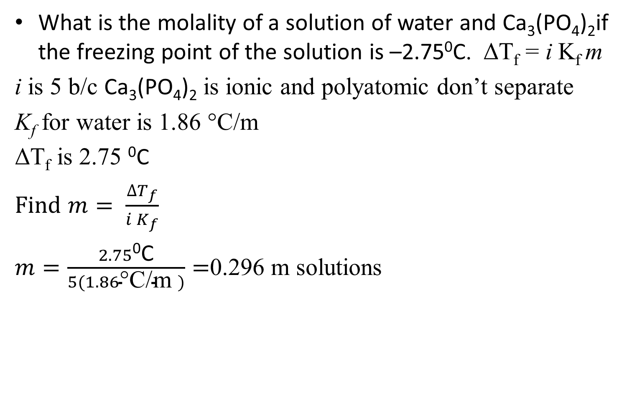
Colligative properties
What is the molality of a solution of water and Ca₃(PO₄)₂if the freezing point of the solution is –2.75⁰C. ΔT_{f} = i K_{f} m
i is 5 b/c Ca₃(PO₄)₂ is ionic and polyatomic don’t separate
K_{f} for water is 1.86 °C/m
ΔT_{f} is 2.75 ⁰C
Find $m= \frac{∆T_{f}}{i K_{f}}$
$m=\frac{2.75\text{0}\text{C}}{5(1.86\text{°}\text{C}\text{/}\text{m} )}=$0.296 m solutions

Slide 36
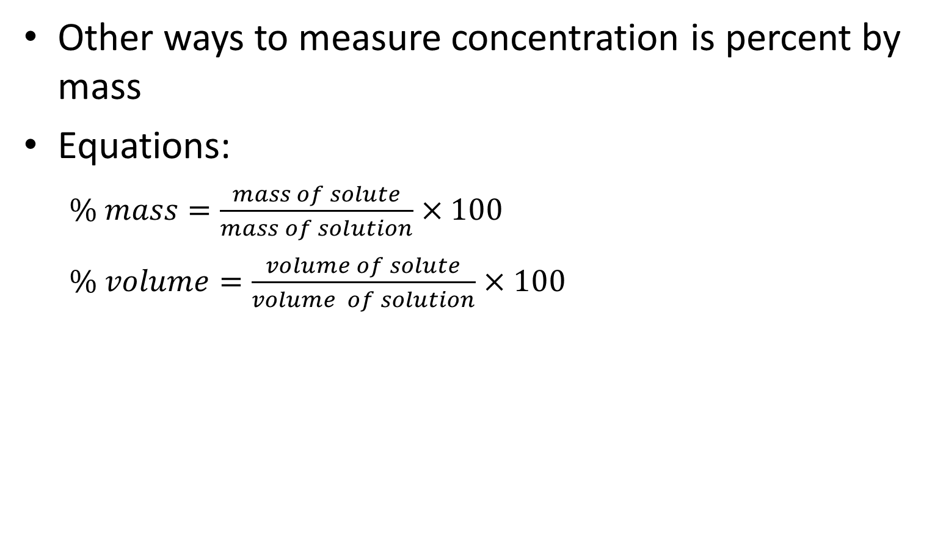
Concentration by % mass or % volume
Other ways to measure concentration is percent by mass
Equations:
  $\% mass=\frac{mass of solute}{mass of solution}×100$
  $\% volume=\frac{volume of solute}{volume of solution}$ $×100$

Slide 37
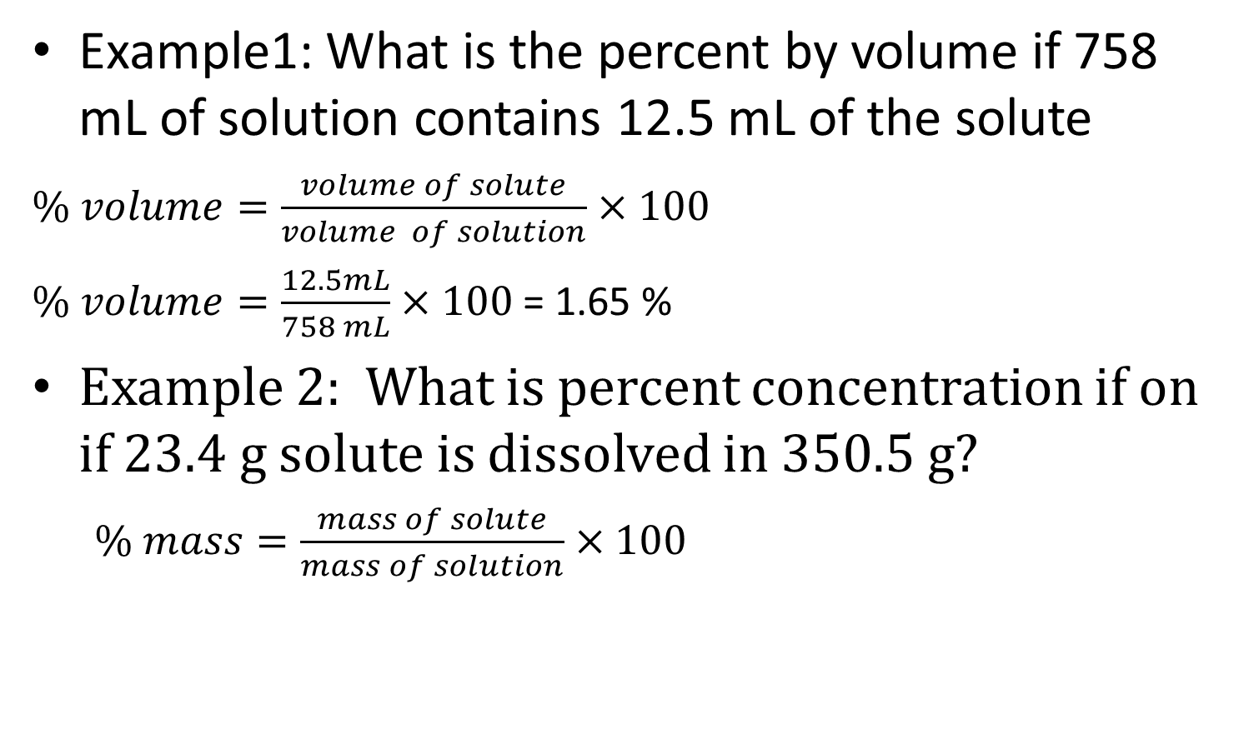
Concentration by % mass or % volume
Example1: What is the percent by volume if 758 mL of solution contains 12.5 mL of the solute
  $\% volume=\frac{volume of solute}{volume of solution}$ $×100$
  $\% volume=\frac{12.5mL}{758 mL}$ $×100$ = 1.65 %
Example 2: What is percent concentration if on if 23.4 g solute is dissolved in 350.5 g?
  $\% mass=\frac{mass of solute}{mass of solution}×100$

Slide 38
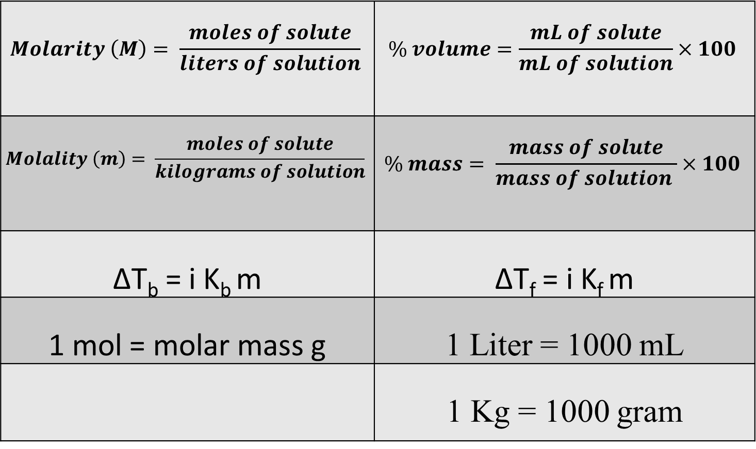
Chemistry Equations
$$Molarity \left(M\right)= \frac{moles of solute}{liters of solution}$$ | $$\% volume=\frac{mL of solute}{mL of solution}×100$$
$$Molality \left(m\right)= \frac{moles of solute}{kilograms of solution}$$ | $$\% mass= \frac{mass of solute}{mass of solution }×100$$
ΔT_{b} = i K_{b} m | ΔT_{f} = i K_{f} m
1 mol = molar mass g | 1 Liter = 1000 mL
 | 1 Kg = 1000 gram

